Slide 1
FACTORS THAT AFFECT THE SALARY IN THE DATA SCIENCE FIELD REPORT.
By erick kinuthia

Slide 2
1.Introduction.
This report offers a comprehensive examination of a dataset containing information on various factors influencing salary categories, including job titles, experience levels, employee residences, company locations, company sizes, employment types, work models, work years, and corresponding salary distributions. Through summary statistics, statistical tests, and predictive modelling techniques, this report aims to uncover insights into the relationships between these factors and salary categories.

Slide 3
2.Summary Statistics
The dataset encompasses categorical variables like job title, experience level, employee residence, company location, company size, employment type, work models, and work years, alongside continuous variables such as salary in USD. Summary statistics unveil essential characteristics and distributions of these variables, offering insights into their central tendencies and variations. Aside is the statistical summary of our Criterion variable
SALARY IN USD
Minimum | 15000
1st quatile | 95000
Median | 138666
Mean | 145561
3rd quatile | 185000
Maximum | 750000

Slide 4
Overal Summary Statistics Of The Encoded Data
VARIABLE | Below USD 138000 | Above USD 138000 | Overall
 | (N=3278) | (N=3261) | (N=6539)
JOB TITTLE
Data scientist | 579 (17.7%) | 703 (21.6%) | 1282 (19.6%)
Others | 2699 (82.3%) | 2558 (78.4%) | 5257 (80.4%)
EXPERIENCE LEVEL
Junior | 1655 (50.5%) | 575 (17.6%) | 2230 (34.1%)
Senior | 1623 (49.5%) | 2686 (82.4%) | 4309 (65.9%)

Slide 5
Overal Summary Statistics Of The Encoded Data
EMPLOYMENT TYPE
Full-time | 3235 (98.7%) | 3257 (99.9%) | 6492 (99.3%)
Part-time | 43 (1.3%) | 4 (0.1%) | 47 (0.7%)
EMPLOYEE'S RECIDENCE
East | 138 (4.2%) | 12 (0.4%) | 150 (2.3%)
West | 3140 (95.8%) | 3249 (99.6%) | 6389 (97.7%)
SALARY CURRENCY
USD | 2557 (78.0%) | 3212 (98.5%) | 5769 (88.2%)
Other currencies | 721 (22.0%) | 49 (1.5%) | 770 (11.8%)

Slide 6
Overal Summary Statistics Of The Encoded Data.
COMPANY LOCATION
East | 114 (3.5%) | 11 (0.3%) | 125 (1.9%)
West | 3164 (96.5%) | 3250 (99.7%) | 6414 (98.1%)
WORK YEAR
Before 2022 | 852 (26.0%) | 549 (16.8%) | 1401 (21.4%)
After 2022 | 2426 (74.0%) | 2712 (83.2%) | 5138 (78.6%)
WORK MODEL
Flexible employment | 1504 (45.9%) | 1267 (38.9%) | 2771 (42.4%)
Non-flexible employment | 1774 (54.1%) | 1994 (61.1%) | 3768 (57.6%)

Slide 7
Overal Summary Statistics Of The Encoded Data.
COMPANY SIZE
Large | 375 (11.4%) | 192 (5.9%) | 567 (8.7%)
Medium | 2758 (84.1%) | 3044 (93.3%) | 5802 (88.7%)
Small | 145 (4.4%) | 25 (0.8%) | 170 (2.6%)

Slide 8
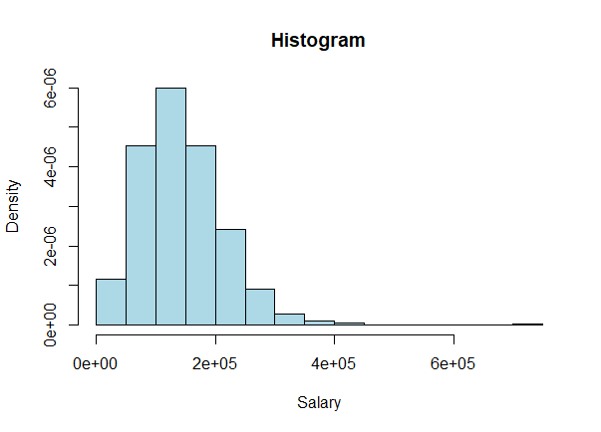
Overview of Visualizations
A variety of visualization techniques were employed to analyze the dataset, including:
i ) Histogram, describing the density of the salary

Slide 9
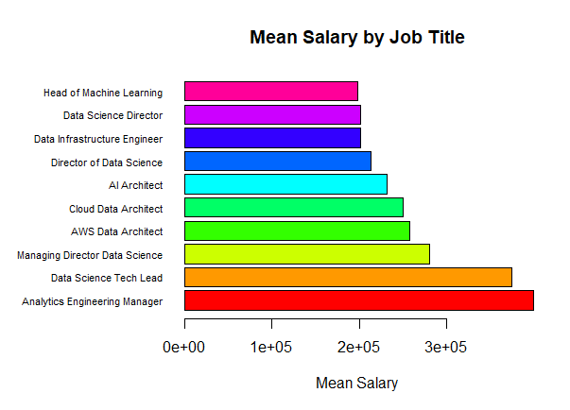
Overview of Visualizations
ii) Barplot, Utilized to visualize the mean salary distribution between the top ten job titles with high paying salary.

Slide 10
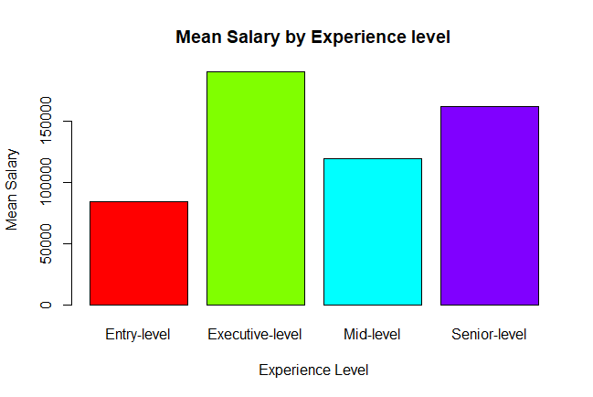
Overview of Visualizations
iii)Bar chart, used to visualize the salary distribution among the work experience of the employees, where on observation, the executive level seems to be paid higher than the rest.

Slide 11
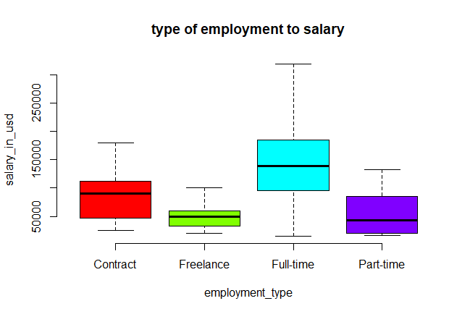
Overview of Visualizations
iv) Box plot, we used it to visualize the salary range between different type of employment modes, where those employed o fulltime basis seemed to be paid more than the rest.

Slide 12
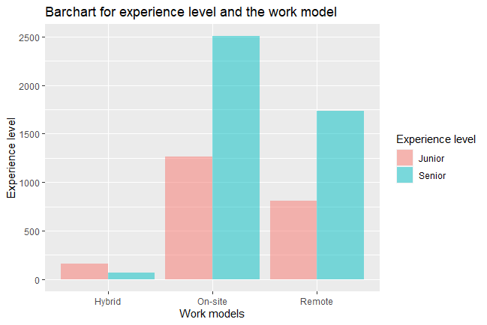
Overview of Visualizations
v) Bar chart, used to visualize the relationship between experience level of a employee and the work model, where most employees who’s work model was on-site ad were junior’s in the data science field experience were many compared to others.

Slide 13
Overview of Visualizations
vi) African map, the map indicates the distribution of salary between employees living in Africa, where we can observe that most employees employed are located in the southern part of Africa.

Slide 14
Statistical Analysis
CHI-SQUARE TEST OF PREDICTORS WITH SALARY CATEGORY
PREDICTOR |  | X-SQUARED | P-VALUE
Experience level |  | 785.25 | <2.2e-16
Job Title |  | 15.731 | 7.30E-05
Employment Type |  | 32.392 | 1.26E-08
Company Location |  | 85.981 | <2.2e-16
Work Year |  | 7.193 | 0.00732
Work Model |  | 33.071 | 8.88E-09
Company Size |  | 157.82 | <2.2e-16

Slide 15
Statistical Analysis
Chi-square Tests: Conducted to explore associations between salary categories and factors like experience level, job title, employment type, company location, work models, and work years. The results indicate statistically significant relationships between salary categories and these factors.

Slide 16
Statistical Analysis
 | MANN WHITNEY TEST BETWEEN THE PREDICTORS AND SALARY CATEGORY
 | VARIABLES |  | 95%CI |  | P-VALUE
 |  |  | LOW | HIGH
 | Job Title |  | 3740 | 11684 | 0.00018
 | Experience Type |  | -58000 | -52000 | <2.2e-16
 | Company Location |  | -94977 | -75009 | <2.2e-16

Slide 17
Statistical Analysis
MANN WHITNEY TEST BETWEEN THE PREDICTORS AND SALARY CATEGORY
VARIABLES |  | 95%CI |  | P-VALUE
 |  | LOW | HIGH
 | Employee's Residence |  | -94101 | -76371 | <2.2e-16
 | Work Model |  | -17693 | -11000 | <2.2e-16
 | Work Year |  | -27967 | -20000 | <2.2e-16
 | Employment Type |  | 55500 | 89667 | 1.07E-13

Slide 18
Statistical Analysis
Mann-Whitney U Test: Utilized to compare salary distributions across different categories, including job titles, employee residences, and work models. Significant differences in salary distributions among these categories were observed.

Slide 19
Statistical Analysis
FISHERS TEST BETWEEN THE PREDICTORS AND THECRITERION(SALARY CATEGORY)
VARIABLE |  | ODDS RATIO |  | 95%CI |  |  | P-VALUE
 |  |  |  | LOW | HIGH
Job Title |  | 0.781 |  | 0.6892 | 0.884 |  | 7.57E-05
Experience Level |  | 4.762 |  | 4.2473 | 5.3436 |  | <2.2e-16
Employment Type |  | 0.092 |  | 0.0241 | 0.0255 |  | 2.49E-06

Slide 20
Statistical Analysis
FISHERS TEST BETWEEN THE PREDICTORS AND THECRITERION(SALARY CATEGORY)
VARIABLE |  | ODDS RATIO |  | 95%CI |  |  | P-VALUE
 |  |  |  | LOW | HIGH
Employee's Residence |  | 11.89 |  | 6.5788 | 23.632 |  | <2.2e-16
Company's Location |  | 10.64 |  | 5.148 | 21.963 |  | <2.2e-16
Work Models |  | 1.334 |  | 1.2078 | 1.4741 |  | 9.85E-09
Work Year |  | 1.735 |  | 1.5354 | 1.9609 |  | <2.2e-16

Slide 21
Statistical Analysis
the p-value = 7.573e-05 for Job Title, which is less that 5%,means that we reject the null hypothesis, thus its statistically significant, the 95% CI also supports the null hypothesis because zero does not lie in between the given ranges. In odds ratio explanation, the the other category is rated to the reference category, in our case, With an odds ratio of 0.7806202,this means that there is a less likelihood ( 0.7806202) that individuals who have other jobs titles earn more than USD 138000 compared to data scientists.
For Experience level, the p-value < 2.2e-16,which is less than 5%, indicates that we reject the null hypothesis, by this the test is statistically significant, also, the 95% CI supports our previous argument because zero does not fall in the range, having the odds ratio as 4.762031,and the reference category for salary category and experience category being below USD 138000 and Learner respectfully, we conclude that individuals who are experts are significantly more likely to have a salary which is above USD 138000 compared to ones who are experts.

Slide 22
Statistical Analysis
For Employment Type, the p-value = 2.493e-09 being less than 5% suggests that we reject the null hypothesis, meaning that the test is statistically significant, also the 95%CI supports our argument because zero does not lie inside its ranges, the odds ratio 0.09243705 suggests that individuals that are employed part time are less likely to have a salary above USD 138000 compared to ones employed fulltime.
In the Employee’s Residence section, The p-value < 2.2e-16 being less than 5% suggests that we reject the null hypothesis, meaning that the test is statistically significant, also the 95%CI supports our argument because zero does not lie inside its ranges, the odds ratio 11.89316,suggests that employees who reside in the west are statistically more likely to earn a salary above USD 138000 compared to those who reside in the East.

Slide 23
Statistical Analysis
For the Company’s Location, the p-value < 2.2e-16 being less than 5% suggests that we reject the null hypothesis, meaning that the test is statistically significant, also the 95%CI supports our argument because zero does not lie inside its ranges, the odds ratio 10.6419 ,suggests that companies that reside in the west are statistically more likely to be paying their employees a salary above USD 138000 compared to those that are in the East.
For the Work Model, the p-value = 9.848e-09 being less than 5% suggests that we reject the null hypothesis, meaning that the test is statistically significant, also the 95%CI supports our argument because zero does not lie inside its ranges, the odds ratio 1.33419 ,suggests that employees with not flexible employment are statistically more likely to be earning a salary above USD 138000 compared to those who employment is flexible.

Slide 24
Statistical Analysis
In the Work Year section, the p-value < 2.2e-16 being less than 5% suggests that we reject the null hypothesis, meaning that the test is statistically significant, also the 95%CI supports our argument because zero does not lie inside its ranges, the odds ratio 1.734689,suggests that employees that were paid after 2022 are statistically more likely to be earning a salary above USD 138000 compared to those that were paid before 2022

Slide 25
Statistical Analysis
CORRELATION TEST BETWEEN THE PREDICTORS AND THE CRITERION (SALARY CATEGORY)
VARIABLE |  | 95%CI |  |  | COR | P-VALUE
 |  | LOW | HIGH
Job Title |  | -0.05149 | -0.00305 |  | -0.02729 | 0.02733
Experience Level |  | 0.33334 | 0.375776 |  | 0.35477 | <2.2e-16
Employment Type |  | -0.10299 | -0.054815 |  | 0.07895 | 1.63E-10

Slide 26
Statistical Analysis
CORRELATION TEST BETWEEN THE PREDICTORS AND THE CRITERION (SALARY CATEGORY)
VARIABLE |  | 95%CI |  |  | COR | P-VALUE
 |  | LOW | HIGH
Work Model |  | 0.091571 | 0.1394073 |  | 0.11556 | <2.2e-16
Work Year |  | 0.12367 | 0.110936 |  | 0.14747 | <2.2e-16
Employee's Residence |  | 0.160499 | 0.2073354 |  | 0.18402 | <2.2e-16
Company's Location |  | 0.140852 | 0.1880174 |  | 0.16453 | <2.2e-16
Company Size |  | 0.003445 | 0.051885 |  | 0.02768 | 0.02519

Slide 27
Statistical Analysis
The job title and salary have a weak negative correlation(r= -0.02729048),this means that, a increase in one, corresponds to a decrease in the other, in our case, data scientists(encoded 0) have more salary than other job titles(encoded 1),the p-value = 0.02733,which is less than 5%(we reject the null hypothesis), gives us the confidence to say that the test is statistically significant, also looking at our 95% CI, zero does not lie in between its ranges.
The relationship between salary and experience level is a moderate positive correlation(r=0.3547685),which means that, employees who are experts(encoded as 1) tends to be paid higher than learners(encoded as 0).The p-value < 2.2e-16,which is less than 5%(we reject the null hypothesis), gives us the confidence to say that the test is statistically significant, also looking at our 95% CI, zero does not lie in between its ranges.

Slide 28
Statistical Analysis
The relationship between salary and employment type is a weak negative correlation(r=-0.07894822),which means that, employees who are employed in part-time bases(encoded as 1) tends to be paid less than those who are employed full-time(encoded as 0).The p-value = 1.628e-10,which is less than 5%(we reject the null hypothesis), gives us the confidence to say that the test is statistically significant, also looking at our 95% CI, zero does not lie in between its ranges.
The relationship between salary and work model is a weak positive correlation(r=0.1155592),which means that, employees who are on non-flexible employment plan (encoded as 1) tends to be paid higher than those with flexible employment plan (encoded as 0).The p-value < 2.2e-16,which is less than 5%(we reject the null hypothesis), gives us the confidence to say that the test is statistically significant, also looking at our 95% CI, zero does not lie in between its ranges.

Slide 29
Statistical Analysis
The relationship between salary and work year is a weak positive correlation(r=0.1474666),which means that, employees who were paid after 2022 (encoded as 1) tends to be paid higher than those who were paid before 2022 (encoded as 0).The p-value < 2.2e-16,which is less than 5%(we reject the null hypothesis), gives us the confidence to say that the test is statistically significant, also looking at our 95% CI, zero does not lie in between its ranges.
The relationship between salary and employee's residence is a weak positive correlation(r=0.1840217),which means that, employees who reside in the west part continents (encoded as 1) tends to be paid higher than those who reside in the east part continents (encoded as 0).The p-value < 2.2e-16,which is less than 5%(we reject the null hypothesis), gives us the confidence to say that the test is statistically significant, also looking at our 95% CI, zero does not lie in between its ranges.

Slide 30
Statistical Analysis
The relationship between salary and company's location is a weak positive correlation(r=0.1645287),which means that, companies located in the west part continents (encoded as 1) tends to pay employees higher than those located in the east part continents (encoded as 0).The p-value < 2.2e-16,which is less than 5%(we reject the null hypothesis), gives us the confidence to say that the test is statistically significant, also looking at our 95% CI, zero does not lie in between its ranges.
The p-value < 2.2e-16,which is less than 5%(we reject the null hypothesis), gives us the confidence to say that the test is statistically significant, also looking at our 95% CI, zero does not lie in between its ranges. The relationship between salary and company's size is a very weak positive linear correlation(r=0.02768125),which means that, as company size increases, so do the salary paid to the employees, but the relationship is not strong enough to make meaningful predictions about salary based solely on company size.

Slide 31

Machine Learning.

Slide 32
Machine Learning
The Gradient Boosting Machine(GBM) :
Confusion Matrix
 |  | Reference
Prediction |  | Below USD 138000 |  | Above USD 138000
Below USD 138000 |  |  | 525 |  | 177
Above USD 138000 |  |  | 429 |  | 831
The top-left cell (525) indicates the number of observations that are actually in the class "Below USD 138000" and were predicted to be in the same class, (429) indicates the number of observations that are actually in the class "Above USD 138000" but were predicted to be in the "Below USD 138000" class.(177) indicates the number of observations that are actually in the class "Below USD 138000" but were predicted to be in the "Above USD 138000" class. (831) indicates the number of observations that are actually in the class "Above USD 138000" and were predicted to be in the same class

Slide 33
Machine Learning
Statistics
Accuracy: | 0.6911
95%CI: | (0.6696,0.711)
P-value: | <2.2e-16
Kappa: | 0.3774
Balanced Accuracy: | 0.6868
"positive" class: | Below USD 138000

Slide 34
Machine Learning
the accuracy(69.11%) is a little better than the other models,so we use this model for prediction,the p-value < 2.2e-16 which is less than 5% gives us the confidence to reject the null hypothesis,also the 95%CI supports our argument.
Cohen's Kappa statistic, which measures the agreement between the model's predictions and the actual classes, corrected for agreement by chance. In this case, it's approximately 0.3774, indicating moderate agreement.
Balanced Accuracy (68.68%) provides a more balanced measure of performance, considering both sensitivity and specificity.
The model performs significantly better than random guessing (NIR) with a p-value less than 2.2e-16.

Slide 35
Conclusion
The analysis reveals valuable insights into the factors influencing salary categories. Statistical tests confirm significant relationships between salary categories and various factors such as experience level, job title, employment type, employee residence, company location, work models, and work years. Machine learning models offer predictive capabilities, with the GBM model achieving the highest accuracy in predicting salary categories. These findings can inform HR practices, workforce planning, and decision-making processes in organizations.

Slide 36
Recommendations
Further explore the identified relationships between salary categories and factors such as job title, experience level, and company location to inform strategic HR initiatives.
Investigate additional features or variables that may enhance predictive modeling accuracy and provide deeper insights into salary determinants.
Continuously monitor and update predictive models to adapt to evolving trends and dynamics in the job market and organizational contexts.

Slide 37
Future Directions
Integration of external data sources and advanced analytical techniques such as natural language processing and sentiment analysis to enrich predictive modeling capabilities.
Longitudinal analyses to examine temporal trends and changes in salary distributions over time, considering economic factors and industry-specific dynamics.
Collaboration with industry partners to validate predictive models and incorporate domain expertise into the analysis for enhanced accuracy and applicability

